Slide 1

Moving sound
A loudspeaker vibrates and makes a sound.
We hear the sound because a sound wave moves through the air.

Slide 2
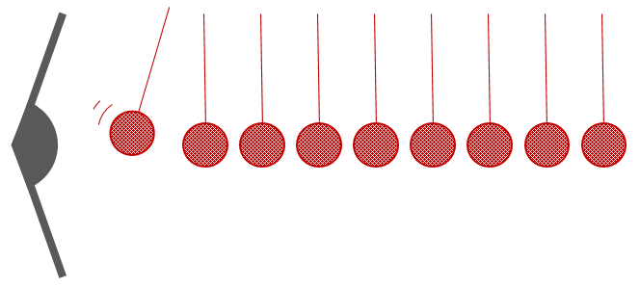
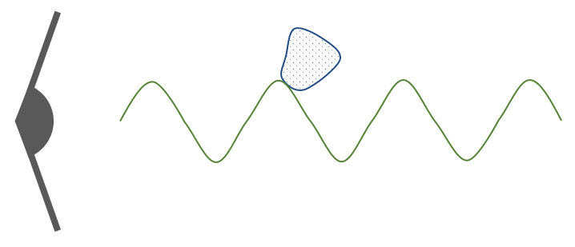

Moving sound
These pictures try to show how a sound wave moves through the air.
Which one is the best model for how a sound wave moves?
A
B
C
D

